Slide 1
Token Ring (IEEE 802.5)
Token ring requires that stations take turns sending data.
Each station may transmit only during its turn and may send only one frame during each turn.
The mechanism that coordinates this rotation is called token passing.

Slide 2
Token Passing

Slide 3
Token Passing

Slide 4
Token Passing

Slide 5
Token Passing

Slide 6
Token Bus (IEEE 802.4)
Token Bus combines features of Ethernet (a bus topology) and Token ring.
Token bus is a physical bus that operates as a logical ring using tokens.
Stations are logically organized into a ring. A token is passed among the stations. If a station wants to send data, it must wait and capture the token.
Token Bus is limited to factory automation and process control and has no commercial applications in data communication.

Slide 7
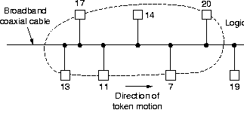
802.4 - Token Bus
Physical line or tree, but logical ring. Stations know “left” and “right” stations. One token “passed” from station to station. Only station with token can transmit.

Slide 8
Token Bus
Physical order of stations does not matter
line is broadcast medium
“Send” token by addressing neighbor
Provisions for adding, deleting stations
Physical layer is not at all compatible with 802.3
A very complicated standard

Slide 9
Token Bus Sub-Layer Protocol
Send for some time, then pass token
If no data, then pass token right away
Set timer for how long to transmit

Slide 10

Token Bus Frame Format
No length field
Data can be much larger (timers prevent hogs)
Frame control

Slide 11
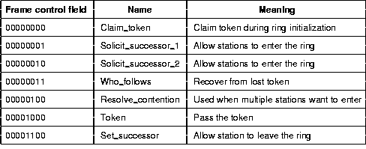
Token Bus Control Frame Summary

Slide 12
Token Ring

Slide 13
IEEE 802.5 - Token Ring
Proposed in 1969 and initially referred to as a Newhall ring.
Token ring :: a number of stations connected by transmission links in a ring topology. Information flows in one direction along the ring from source to destination and back to source.
Medium access control is provided by a small frame, the token, that circulates around the ring when all stations are idle. Only the station possessing the token is allowed to transmit at any given time.

Slide 14
Token Ring Operation
When a station wishes to transmit, it must wait for token to pass by and seize the token.
One approach: change one bit in token which transforms it into a “start-of-frame sequence” and appends frame for transmission.
Second approach: station claims token by removing it from the ring.
Frame circles the ring and is removed by the transmitting station.
Each station interrogates passing frame, if destined for station, it copies the frame into local buffer. {Normally, there is a one bit delay as the frame passes through a station.}

Slide 15
Token Ring Network
with star topology
Copyright ©2000 The McGraw Hill Companies
Leon-Garcia & Widjaja: Communication Networks
Figure 6.58

Slide 16
Token Ring (IEEE 802.5)
Access Method: Token passing
Whenever the network is unoccupied, it circulates a simple three-byte token.
This token is passed from NIC to NIC in sequence until it encounters a station with data to send.
That station waits for the token to enter its network board. If the token is captured the station may send a data frame.
This data frame proceeds around the ring regenerated by each station.

Slide 17
Token Ring (IEEE 802.5)
Each intermediate station examines the destination address, if the frame is addressed to another station, the station relays it to its neighbor.
If the station recognizes its own address, copies the message, checks for errors, and changes four bits in the last byte of the frame to indicate address recognized and frame copied.
The full packet then continues around the ring until it returns to the station that sent it.

Slide 18
Token Ring (IEEE 802.5)
The sender receives the frame and recognizes itself in the source address field. It then checks the address- recognized bits. If they are set, it knows that the frame was received.
The sender then discards the used data frame and releases the token back to the ring.

Slide 19
Priority and reservation
A busy token can be reserved by a station waiting to transmit regardless of that station’s location on the ring.
Each station has a priority code. As a frame passes by, a station waiting to transmit may reserve the next open token by entering its priority code in the access control (AC) field of the data (reservation by other stations) frame. Token releasing station insert this highest priority code into the token frame.
A station with a higher priority may remove a lower priority reservation and replace it with its own.

Slide 20
Monitor stations
Several problems may occur to disrupt the operation of a token ring network.
A station may neglect to retransmit a token
A token may be destroyed by noise
A sending station may not release the token once its turn has ended
A sending station may neglect to remove its used data frame from the ring
In the cases 1,2,3 there is no token on the ring and no station may send data.
To handle these situations, one station on the ring is designated as monitor station.

Slide 21
The monitor sets a timer each time the token passes. If the token does not reappear in the allotted time, it is presumed to be lost and the monitor generates a new token and introduces it into the ring.
The monitor guards against perpetually recirculating data frames by setting a bit (status bit) in the AC (access control) field of each frame.
If the status bit has been set, it knows that the packet has already been around the ring and should be discarded. The monitor destroys the frame and puts a token into the ring.

Slide 22
Addressing
Token ring uses a six-byte address, which is imprinted on the NIC card.
Data Rate
Token ring supports data rates of 4 and 16 Mbps.
Frame formats
The token ring protocol specifies three types of frames:
Data/command Frame
Token Frame
Abort Frame

Slide 23
The data/command frame is the only one of the three types of frames that can carry a PDU and is the only addressed to a specified destination.
The nine fields of the frame are start delimiter (SD), access control (AC), frame control (FC), destination address (DA), source address (SA), PDU, CRC, end delimiter (ED), frame status (FS).
The AC field is one byte long and includes four subfields:
Priority ( 3 bits), Token ( 1 bit), Monitor/status (1bit), reservation (3bits)

Slide 24
Priority bits : Restrict access to stations that have higher priority; Token bit: 1 indicates that the frame type is a data/command frame; 0 indicates a token or abort frame; Status bit: Stops recirculation of frames; Reservation bits: Used by stations which have higher priority than currently transmitting station to reserve for next round and these bits will be reinstated to original value after use.
The frame control (FC) field is one byte long and contains two fields: type and special information.
Type is one bit field used to indicate the type of information contained in the PDU (control information or data).
Special information field is a 7 bits field. This field contains information used by the Token ring logic.

Slide 25
The last byte of the frame is the Frame status field (FS).
It can be set by the receiver to indicate that the frame has been read, or by the monitor to indicate that the frame has already been around the ring.
Token frame
This frame includes only three fields:
The SD, AC, and ED.
The SD and ED indicate that a frame is beginning and ending.
The AC indicates that the frame is a token and includes the priority and reservation fields. (status bit setting only in Data frame)

Slide 26
Abort frame (2 bytes)
An abort frame carries no information at all, just starting and ending delimiters.
It can be generated either by the sender to stop its own transmission or by the monitor to purge an old transmission from the line.

Slide 27
Re-inserting (Releasing) Token
Choices:
After station has completed transmission of the frame.
After leading edge of transmitted frame has returned to the sending station
The essential issue is whether more than one frame is allowed on the ring at the same time.

Slide 28
IEEE 802.5 Token Ring
4 and 16 Mbps using twisted-pair cabling with differential Manchester line encoding.
Maximum number of stations is 250.
Waits for last byte of frame to arrive before reinserting token on ring {new token after received}.
8 priority levels provided via two 3-bit fields (priority and reservation) in data and token frames.
Permits 16-bit and 48-bit addresses (same as 802.3).

Slide 29
Token Ring
Under light load – delay is added due to waiting for the token.
Under heavy load – ring is “round-robin”
The ring must be long enough to hold the complete frame.
Advantages – fair access
Disadvantages – ring is single point of failure, added issues due to token maintenance.

Slide 30
Token Maintenance Issues
What can go wrong?
Loss of token (no token circulating)
Duplication of token (forgeries or mistakes)
The need to designate one station as the active ring monitor.
Persistently circulating frame/token
Deal with active monitor going down.

Slide 31
Token Ring Frame
31

Slide 32
IEEE 802.5 Token and data frame structure
Token Frame Format
SD
AC
ED
Data Frame Format
1
1
1
2 or 6
2 or 6
4
1
1
SD
AC
Destination
Address
Source
Address
Information
FS
FC
FCS
ED
Starting
delimiter
J K 0 J K 0
0
0
J, K non-data symbols (line code)
Access
control
PPP Priority; T Token bit
M Monitor bit; RRR Reservation
P P P
T
M
R R R
Frame
control
FF frame type
ZZZZZZ control bit
F F
Z Z Z Z Z Z
Ending
delimiter
J K 1 J K 1
I intermediate-frame bit
E error-detection bit
I
E
A address-recognized bit
xx undefined
C frame-copied bit
Frame
status
A
C
x x
A
C
x x
Copyright ©2000 The McGraw Hill Companies
Leon-Garcia & Widjaja: Communication Networks
Figure 6.61

Slide 33
Fiber Distributed Data Interface (FDDI)

Slide 34
Fiber Distributed Data Interface (FDDI)
FDDI uses a ring topology of multimode or single mode optical fiber transmission links operating at 100 Mbps to span up to 200 kms and permits up to 500 stations.
Employs dual counter-rotating rings.
16 and 48-bit addresses are allowed.
In FDDI, token is absorbed by station and released as soon as it completes the frame transmission {release after transmission}.

Slide 35
FDDI Token Ring
A
E
B
C
D
Copyright ©2000 The McGraw Hill Companies
Leon-Garcia & Widjaja: Communication Networks
Figure 6.62

Slide 36
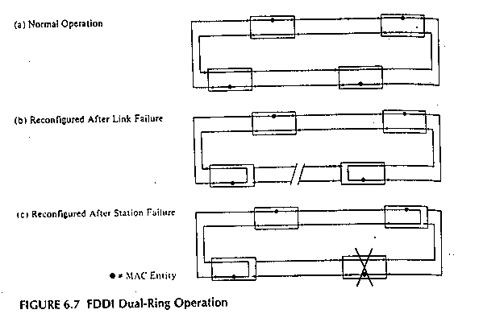
FDDI Repair

Slide 37
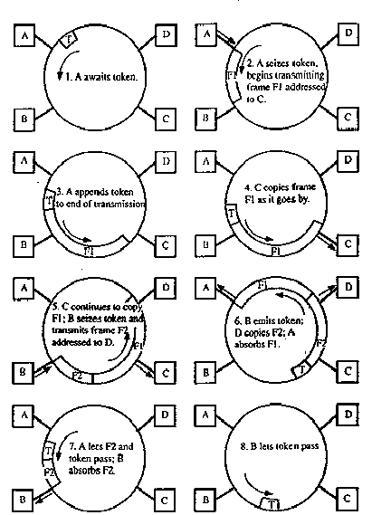
FDDI Ring
Operation

Slide 38
FDDI
To accommodate a mixture of stream and bursty traffic, FDDI is designed to handle two types of traffic:
Synchronous frames that typically have tighter delay requirements (e.g., voice and video)
Asynchronous frames have greater delay tolerances (e.g., data traffic)
FDDI uses TTRT (Target Token Rotation Time) to ensure that token rotation time is less than some value.

Slide 39
FDDI frame structure
Token Frame Format
PRE
SD
FC
ED
Data Frame Format
8
1
1
2 or 6
2 or 6
4
1
1
PRE
SD
FC
Destination
Address
Source
Address
Information
FCS
ED
FS
Preamble
Frame
Control
CLFFZZZZ C = Synch/Asynch
L = Address length (16 or 48 bits)
FF = LLC/MAC control/reserved frame type
ZZZZ = Sub-type of control frame
Leon-Garcia & Widjaja: Communication Networks
Figure 6.63

Slide 40
Differences between 802.5 and FDDI
FDDI
Optical Fiber
100 Mbps
Reliability specified (dual ring)
4B/5B encoding
Distributed clocking
Timed Token Rotation Time
New token after transmit
Token Ring
Shielded twisted pair
4, 16 Mbps
No reliability specified
Differential Manchester
Centralized clock
Priority and Reservation
New token after receive

